Slide 1



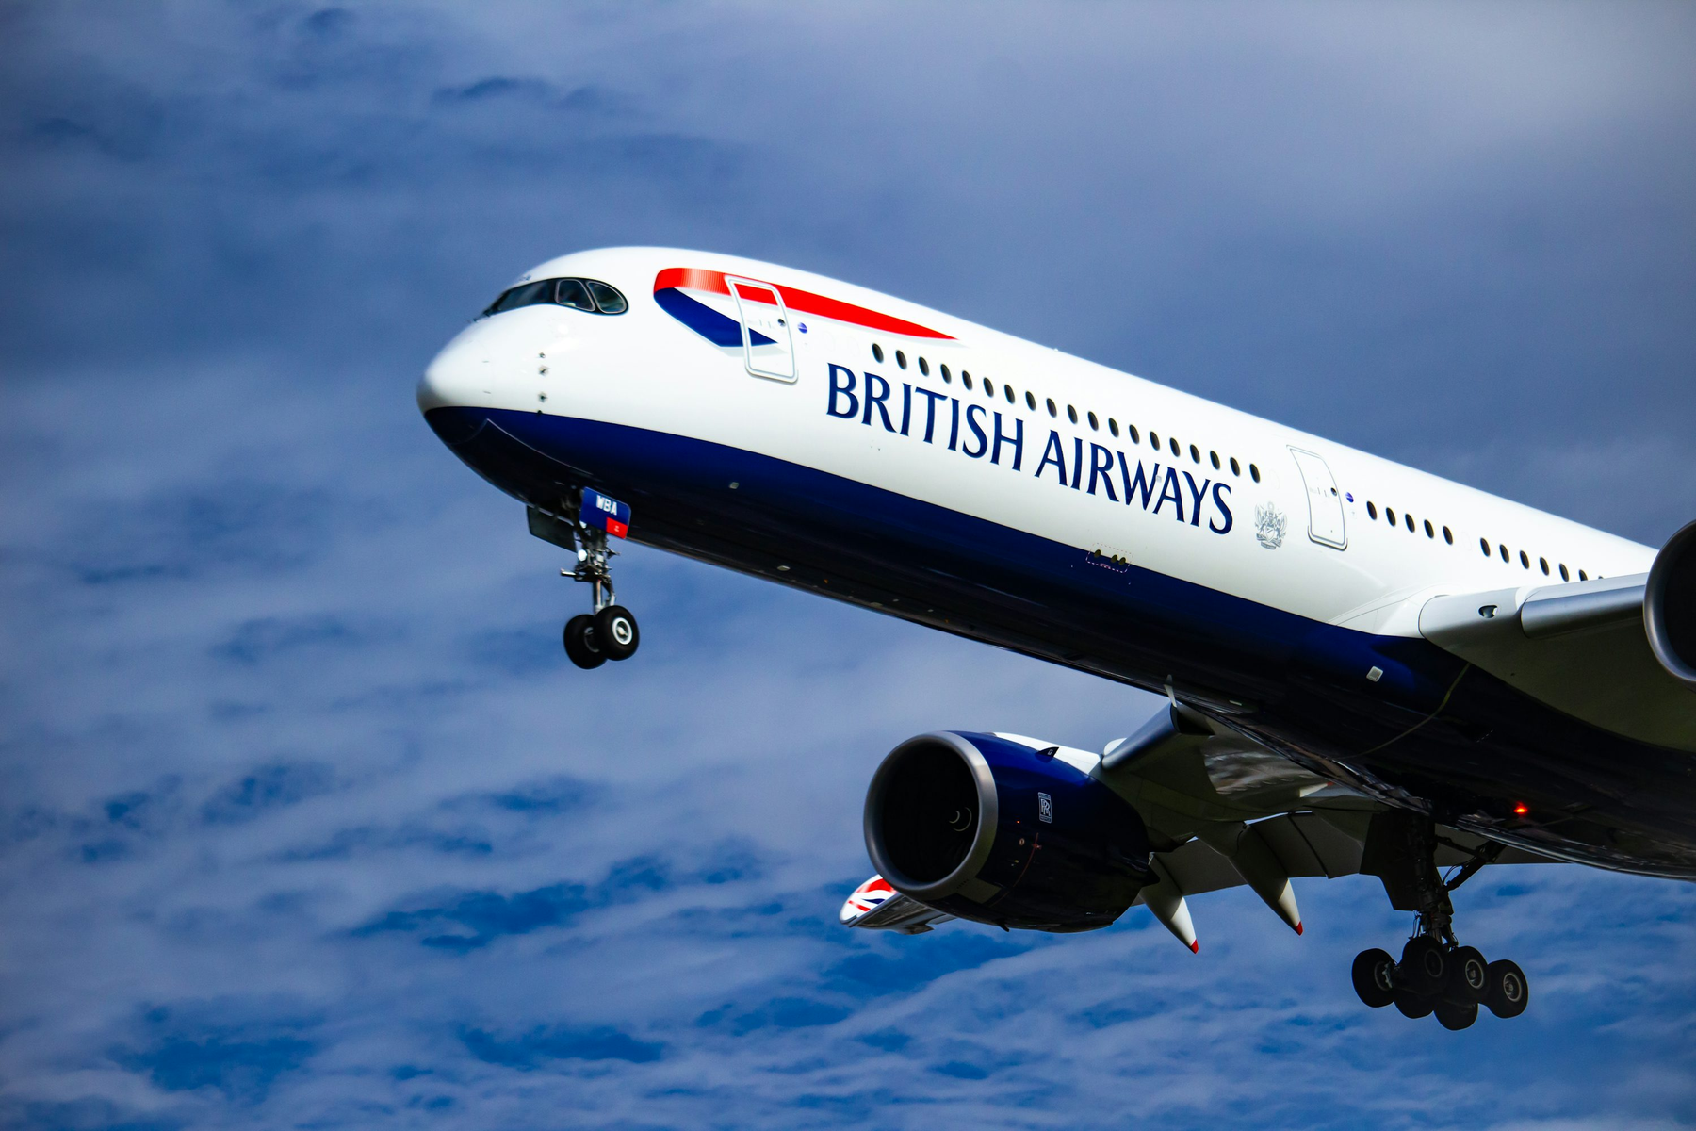



BRITISH AIRWAYS FLIGHT ANALYSIS
Presented By : B.Nitya Reachel

Slide 2

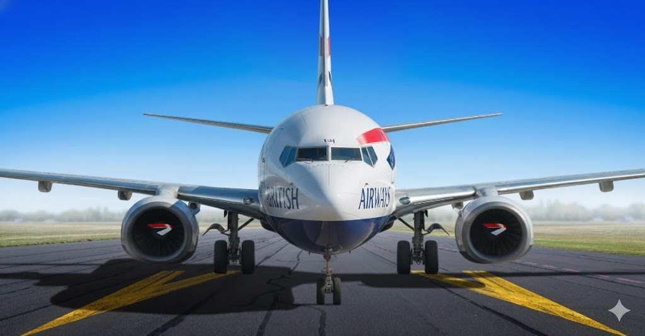
PROJECT OVERVIEW
The Dataset: Analysis of over 10,000 flight records from the 2025 Summer Schedule.
Staffing Optimization: Identifying peak travel periods to ensure correct staffing levels during the busy summer months.
Fleet Management: Tracking aircraft utilization to see which models are driving the most volume across the network.
Loyalty Monitoring: Measuring the volume of Gold and Silver members to maintain premium service during high-demand periods.

Slide 3
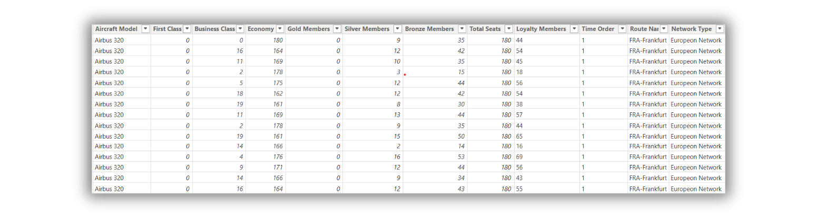
DATA PREPARATION
Dataset Scale: Processed 10,000 rows of flight data, expanding from 23 to 28 columns.
Data Refinement: Renamed technical headers (e.g., AIRCRAFT_NAME) to labels like Aircraft Model.
Capacity Metrics: Created a 'Total Seats' calculation to measure the combined volume of all cabin classes.

Slide 4
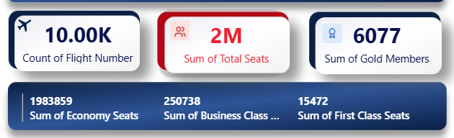
OPERATIONAL KEY PERFORMANCE INDICATOR ( KPI )
Scale of Operations: Tracking over 10,000 flights across the 2025 summer season.
Global Capacity: Managing a total volume of 2 Million+ seats.
VIP Tracking: Identifying 15,000+ Gold Members to ensure premium service standards.
Product Mix: Visualizing the split between Economy, Business, and First Class seats.

Slide 5
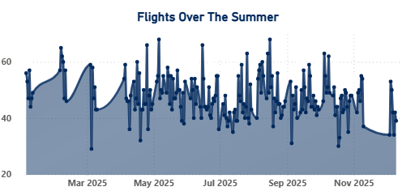
FLIGHT TRENDS & PEAK DEMAND
The Daily Pulse: This chart shows the "heartbeat" of the airline—how many flights are in the air each day.
Identifying Peaks: It clearly shows the busiest days when flight frequency is at its highest.
Staff Planning: Managers can use these "spikes" to decide when to schedule more staff at the airport.
Schedule Overview: It tracks the entire 2025 season, showing how demand grows from Spring into Summer.

Slide 6
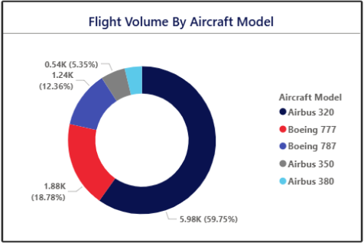
FLEET UTILIZATION
Our Main Plane: The Airbus 320 is our most used aircraft.
Fleet Split: Shows the percentage of flights handled by each plane type.
Usage Tracking: Helps managers see which planes are working the hardest.
Quick View: The donut chart makes it easy to see the biggest "slice" of our operations.

Slide 7
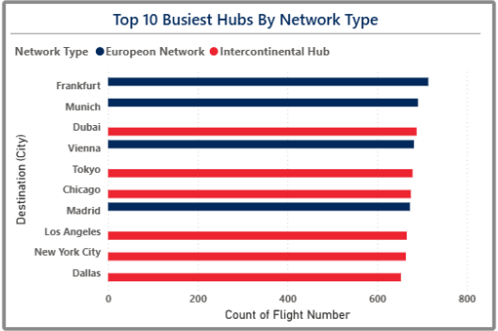
TOP DESTINATIONS
Top Hubs: Shows the top 10 cities we fly to most often.
Busy Routes: Frankfurt and Munich are our busiest destinations.
Airport Planning: Helps us know where we need the most gate space.
Traffic View: Ranks cities from highest to lowest flight volume.

Slide 8

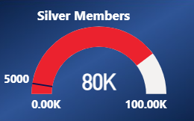

VIP VOLUME & FLIGHT NETWORKS
Service Demand: Tracking 80,000 Silver Members to predict airport lounge and check-in crowds.
Network Split: Grouping flights into European Hub and Intercontinental for better planning.
Time Filters: Buttons to see the schedule for Morning, Lunch, and Evening.
Interactive Planning: Helping managers see if the "Morning" rush is mostly European or Intercontinental flights.

Slide 9
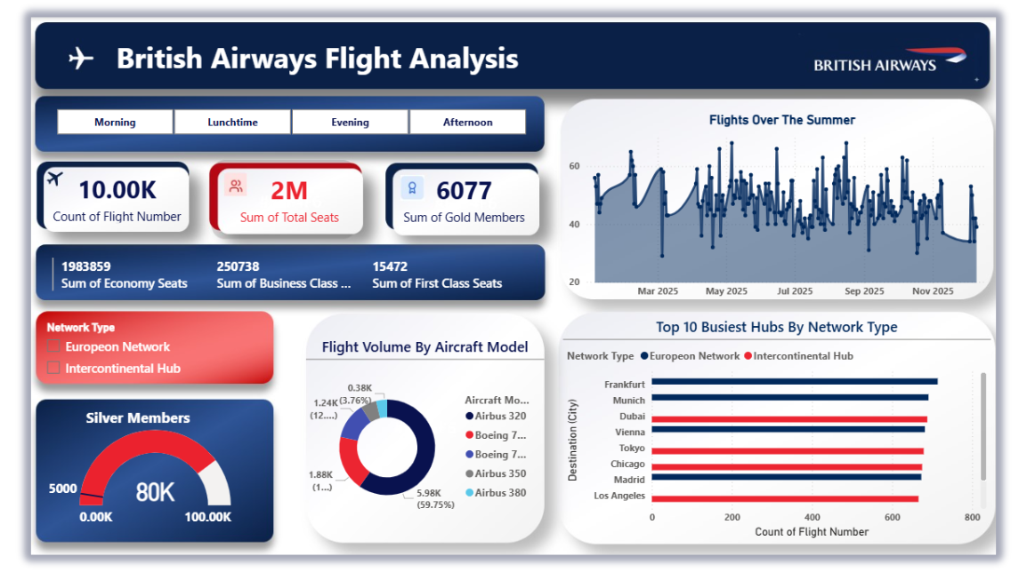
DASHBOARD

Slide 10
CONCLUSION
From Raw to Refined: Successfully turned 10,000 flight records into a single, interactive dashboard.
Operational Overview: Clearly identified the Airbus 320 and European Hubs as the backbone of the summer schedule.
Loyalty Focus: Created a dedicated system to monitor 80,000 Silver members for better service.
Better Decisions: Replaced manual spreadsheets with a visual tool that shows when and where the airline is busiest.

Slide 11
FUTURE SCOPE
Real-Time Connection: Moving from a static dataset to a Live Data Feed for up-to-the-minute tracking.
Profitability Mapping: Adding Ticket Revenue to see which "Intercontinental" flights are making the most money.
Predictive Analysis: Using this year's data to forecast passenger demand for the 2026 season.
Customer Feedback: Linking passenger survey scores to specific routes to improve the flight experience.

Slide 12

THANK YOU

